Slide 1
Access to Data- Penn Information Systems (IT)
November 13, 2019

Slide 2
Agenda – Access to data
Prepatory to Research
  Feasibility
  Cohort Identification
Access to Data Post IRB Approval
  Recruitment
    PennChart
    My Penn Medicine (MPM)
    iConnect Registry

Slide 3
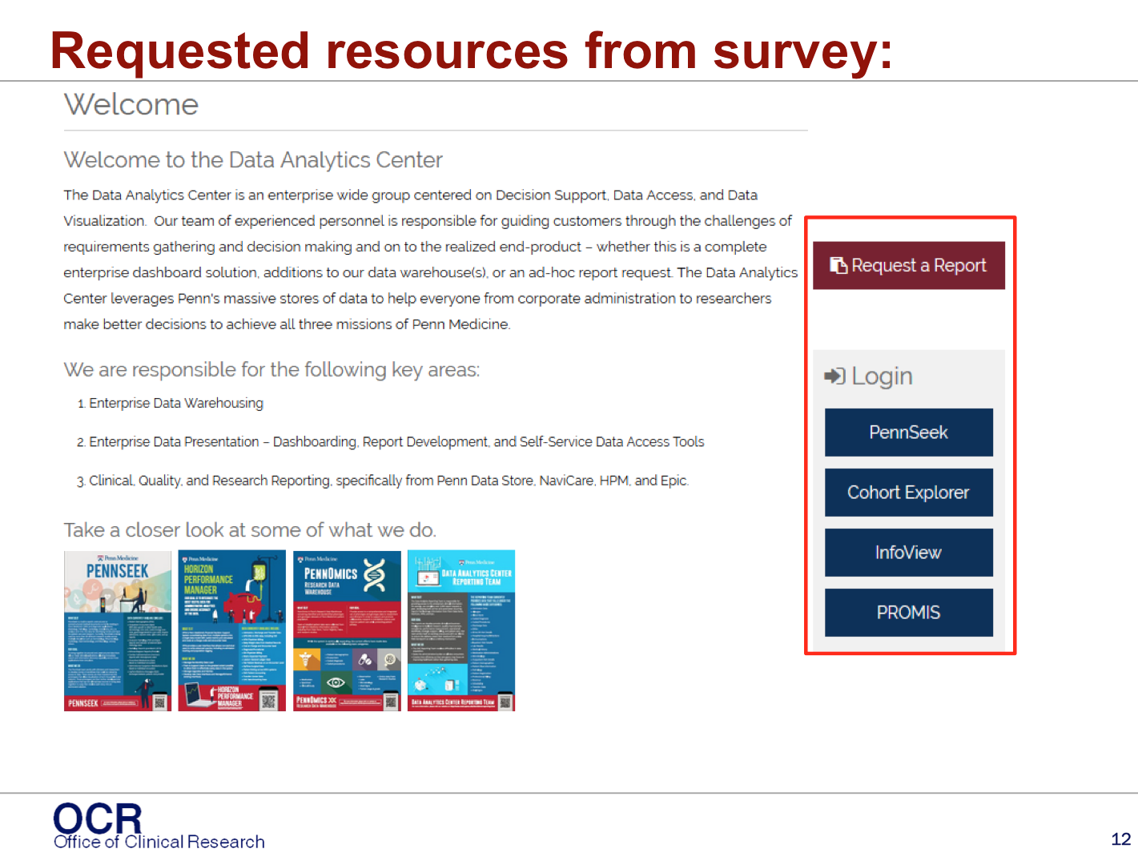

Data Analytics Center
Data Analytics Center- Recruitment via EMR
  Feasibility numbers and subject PHI are available via the Penn Data Warehouse.
  Research requests can be submitted to the DAC team for patient counts
    Used when writing ones own research protocol or proposal
    Patient count/query to use later for recruitment
Data Analytics Center- http://www.med.upenn.edu/dac/penn-data-store-warehouse.html.

Slide 4

Recruitment through IT platforms/ systems:
PennChart: Penn Medicine’s EMR (EPIC)
BPAs= Best Practice Advisory:
  Function in PennChart’s decision support engine
  used to alert users at the point of care based on specific patient criteria and then approach them for research.
  Requires submission of request to PennChart Research, approval thru specific committees and IT build.
  Contact OCR while writing up protocol or before IRB submission.
MyPennMedicine Questionnaires:
  MPM= PennChart Patient Portal
  Questionnaires used to collect information from patients relevant to their health through the patient portal
  Patient responses are stored in the patient’s records and can be used for patient care, quality reporting and research purposes.
  Research questionnaires can be sent via MPM to study specific patients, after approval from PennChart Research, specific committees and IT.
Recruitment messages thru MPM:
  IRB approved messages to be sent to potentially eligible participants via MPM.
  Indicate their research status in MPM
  Still in pilot phases with 1 study- not approved overall. Please contact OCR for future requests.

Slide 5
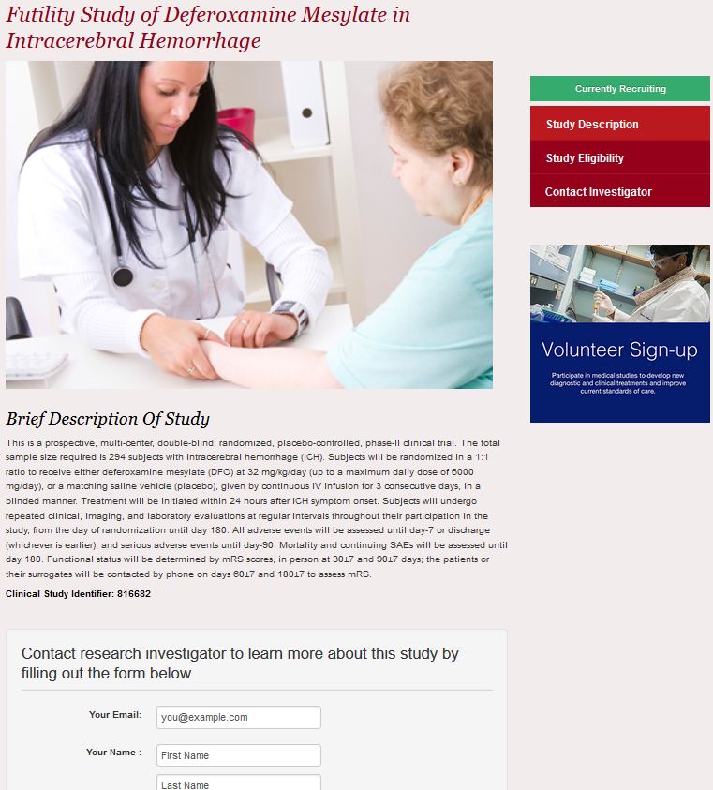
Recruitment through IT platforms/ systems:
iConnect: Penn Medicine’s Clinical Trial Web Portal
Patient driven trial search
Unique web page for each trial
Patient can contact study team via messaging platform.
Online training via electronic module on KL
iConnect search linked via Pennmedicine.org and MyPennMedicine (MPM)
With new functionality goal is to use iConnect as a Clinical trial recruitment management system.

Slide 6
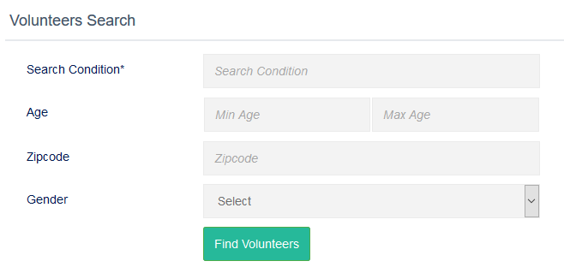
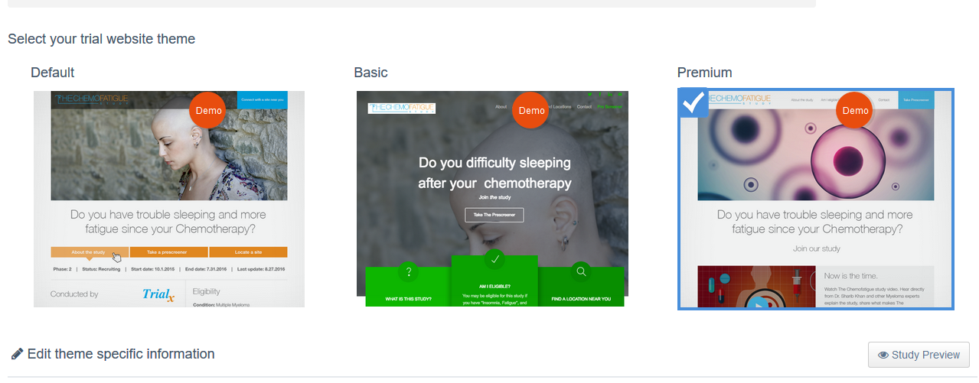
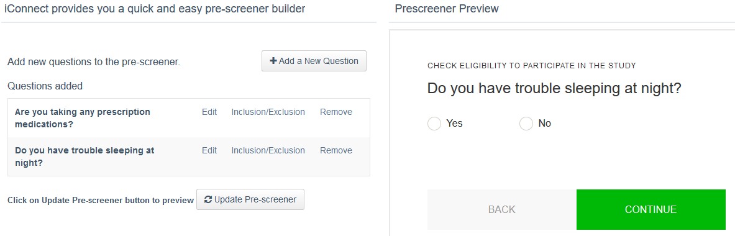
iConnect: Ways to recruit thru this system
  Volunteer Registry – IRB approval required to obtain PHI
Website creation per study- few clicks, study team creates their own instant website.
Pre-screener for eligibility built into trial page- helps w/ screening out false positives before you see patients on site.

Slide 7
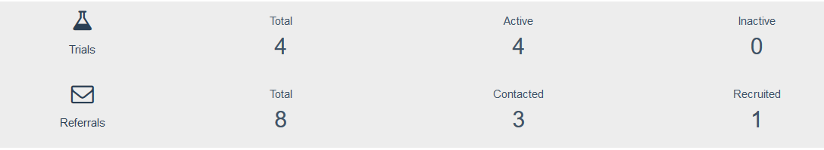
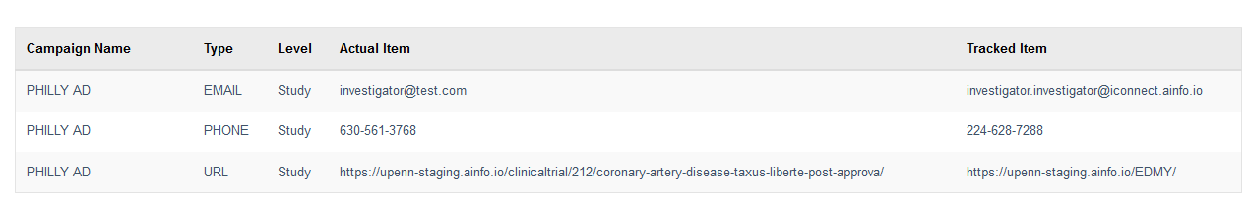
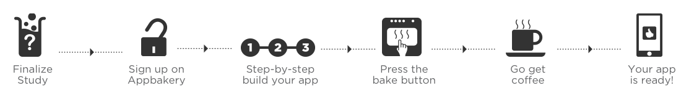
iConnect: Ways to recruit thru this system
Reporting Dashboard – Metrics of trial views, referrals at a glance
Referral & Recruitment campaign tracker- ability to track metrics real time and longitudinally to help study team decide whether a change in strategy is required
App Bakery: Why build code, when you can bake an app?
  DIY web based study app builder that requires no programming,
  App specifications are built through a web interface
  Creates an App for both iOS and Android within minutes
  Cost calculator, health specialties apps can be made for plus more info here: http://trialx.com/appbakery

Slide 8
For More Information
Office of Clinical Research (OCR)
https://www.med.upenn.edu/ocr/
psom-ocr@pobox.upenn.edu
PennChart Research IS Team
IS Service Portal: https://uphsnet.uphs.upenn.edu/athenaselfservice
pennchartresearch@uphs.upenn.edu
Data Analytics Center
https://www.med.upenn.edu/dac/
  .

